Slide 1
TAG: Transfer Application Guarantee for UCs
Mammoth Lakes Foundation Scholarship Brunch
September 17, 2021 10AM-11AM
Presented by: Deanna Campbell

Slide 2
TAG: UC Transfer Admission Guarantee
WHAT is TAG?
Guaranteed admission to one of six University of California (UC) campuses
WHERE can you go on TAG?
Davis, Irvine, Merced, Riverside, Santa Barbara, Santa Cruz
WHO is TAG for?
For students from any California Community College (CCC)
WHY is TAG so AMAZING?
Ensures enrollment to a specific UC campus by meeting all requirements!

Slide 3
TAG: UC Transfer Admission Guarantee
HOW do you start the TAG?
Use the Transfer Planning Tools: ASSIST, UC TAP, and Transfer Pathways Guide online!
https://admission.universityofcalifornia.edu/admission-requirements/transfer-requirements/transfer-planning-tools/
Choose your campus https://admission.universityofcalifornia.edu/counselors/files/tag-matrix.pdf
Complete TAG application via UC TAP
Fulfill all your requirements (coursework and GPA)
Submit the final US Application
WHEN do you apply for TAG? *BOTH TAG & UC APPLICATION MUST BE COMPLETED!!
September 1-30, 2021 complete TAG for Fall 2022 Admission
(November 1-30, 2021 submit UC application for undergraduate admission)
May 1-31, 2022 complete TAG for Winter/Spring 2023 Admission
(November 1-30, 2022 submit UC application for undergraduate admission)

Slide 4
12 Things You Need to Know to TAG a UC
You must be currently attending a California Community College (CCC).
You must fulfill the definition of a CCC student (must have at least 30 UC-transferable units by end of final spring term, and last fall/spring semester must be at a CCC)
TAG non-eligibility: you are not eligible for TAG if you already have a bachelor’s degree, graduate degree, or professional degree. If you were previously enrolled in a UC you cannot TAG the UC you attended. You cannot be currently enrolled in high school.
Completing the TAG application. The application is online from September 1-30 for admission the following fall. Or, May 1-30 for admission the following spring. You must also submit the regular UC application during November 1-30.
TAG approval is conditional. Most of the six UCs let you know of the conditional approval in early November. The approval is based on your fulfillment of all remaining coursework and GPA requirements per the TAG agreement for that UC
Does conditional mean it’s not a guarantee? TAG approval is a guarantee assuming you fulfill the contract stipulations through the end of spring term. Possible reasons for rejection might include: getting a D or F in any subsequent term; falling below the minimum cumulative GPA requirement for the specific TAG; not fulfilling major requirements; under 60 semester (90 quarter) unites by final spring term.

Slide 5
12 Things You Need to Know to TAG a UC, cont’d.
What happens if I am rejected from TAG? If your TAG application is rejected you are funneled over into the regular application pool. And BTW, if your TAG is approved, you are not obligated to attend that UC.
Majors excluded from TAG. Some UCs have majors that are excluded from TAG. See TAG matrix for details: https://admission.universityofcalifornia.edu/counselors/files/tag-matrix.pdf
TAG unit limits. The total UC-transferable units from a CCC or any non-CCC cannot go over the ceiling limits set by each UC. If all your units by end of spring are lower division, you will not hit the ceiling so don’t worry. Upper division courses, however, can place you above the ceiling limits.
The two English course requirement. See TAG matrix above for details.
Math requirement. The required math course must be completed by fall.
Is IGETC required for TAG. No, it is not required except for certain programs (see TAG matrix).

Slide 6
FREE!! Stress management & Mental Health Resources

Slide 7
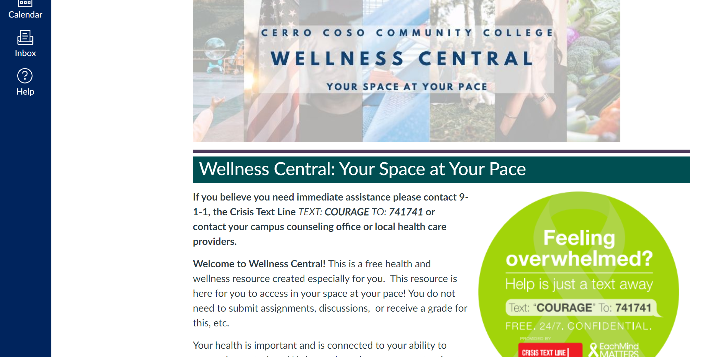
https://kccd.instructure.com/courses/43762

Slide 8
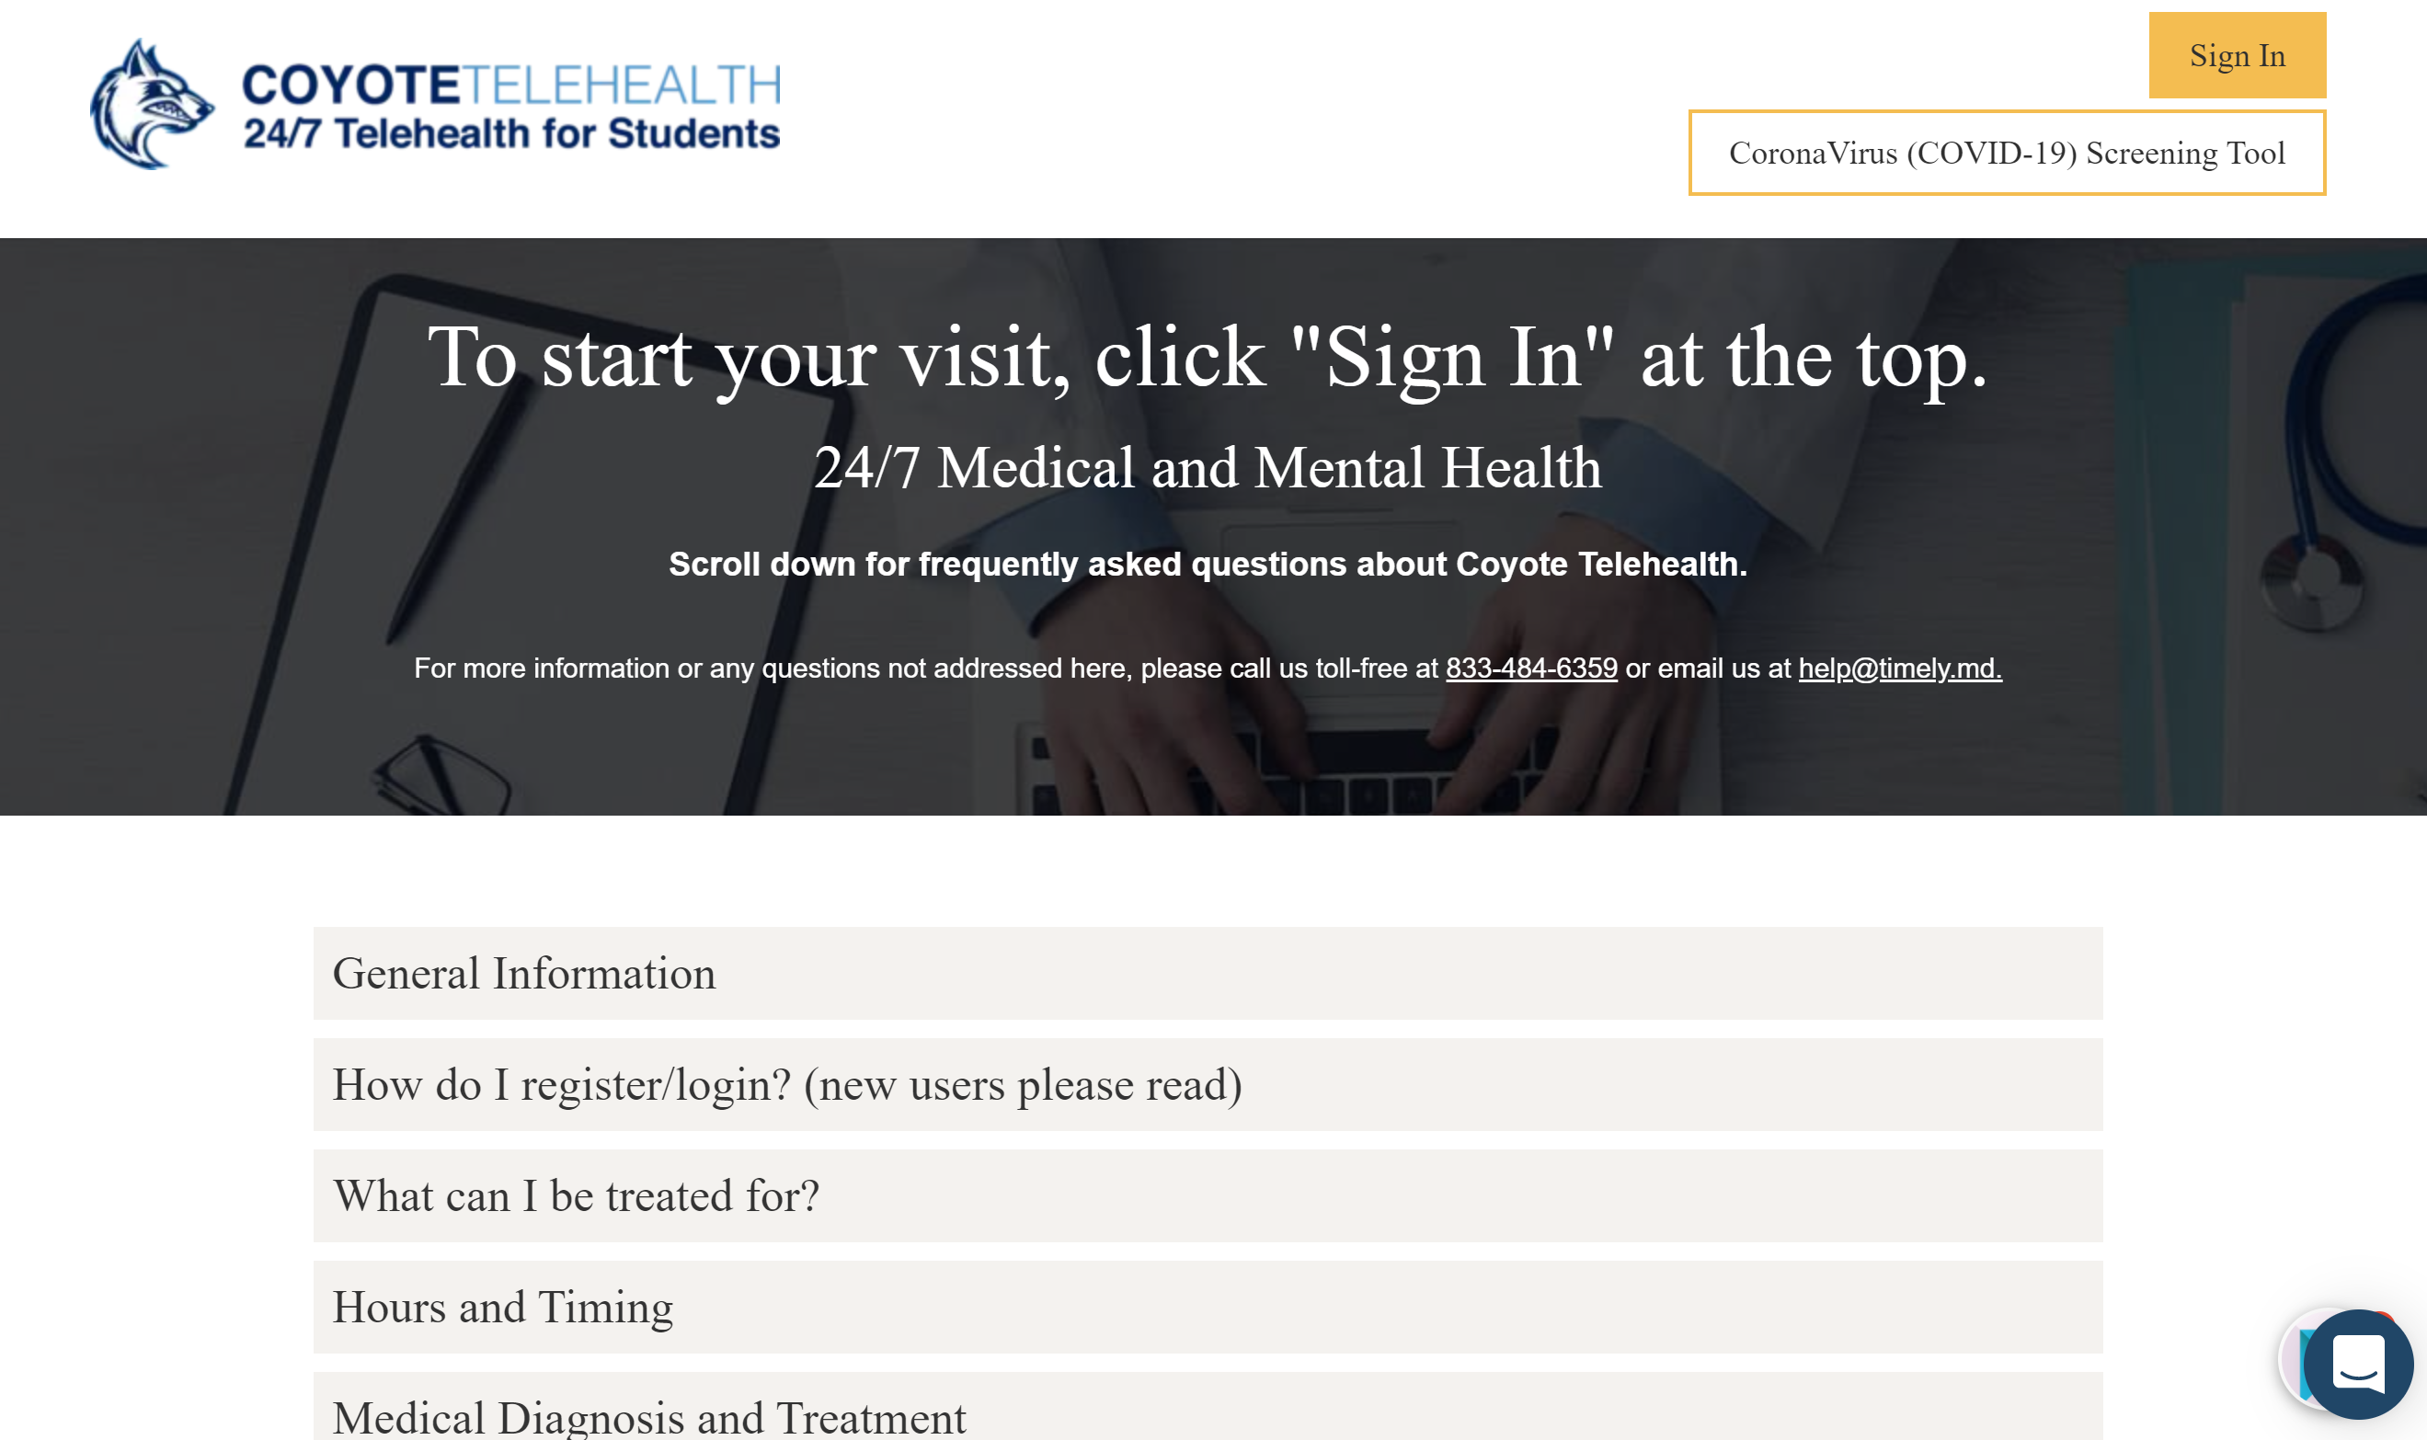
https://www.timely.md/faq/coyote-telehealth-cerro-cosso-community-college/

